Slide 1
An Overview of Clustering Methods
Dr. Muhammad Tahir
Assistant Professor
COMSATS University Islamabad,
Attock Campus

Slide 2
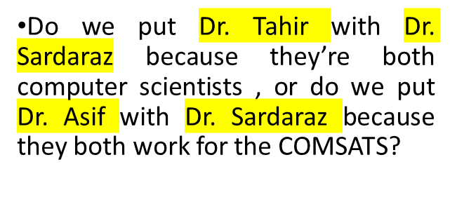




What is Clustering?
Given a collection of objects, put objects into groups based on similarity.
Used for “discovery-based” science, to find unexpected patterns in data.
Also called “unsupervised learning” or “data mining”
Inherently an ill-defined problem
CS Faculty
Mathemat-ician
COMSATS
COMSATS

Slide 3
Data Representations for Clustering
Input data to algorithm is usually a vector (also called a “tuple” or “record”)
Types of data
  Numerical
  Categorical
  Boolean
Example: Clinical Sample Data
  Age (numerical)
  Weight (numerical)
  Gender (categorical)
  Diseased? (boolean)
Must also include a method for computing similarity of or distance between vectors

Slide 4
Calculating Distance
Distance is the most natural method for numerical data
Lower values indicate more similarity
Distance metrics
  Euclidean distance
  Manhattan distance
  Etc.
Does not generalize well to non-numerical data
  What is the distance between “male” and “female”?

Slide 5
Calculating Numerical Similarity
Traditionally over the range [0.0, 1.0]
  0.0 = no similarity, 1.0 = identity
Converting distance to similarity
  Distance and similarity are two sides of the same coin
  To obtain similarity from distance, take the maximum pairwise distance and subtract from 1.0
Pearson correlation
  Removes magnitude effects
  In range [-1.0, 1.0]
    -1.0 = anti-correlated, 0.0 = no correlation, 1.0 = perfectly correlated
  In the example below, the red and blue lines have high correlation, even though the distance between the lines is significant

Slide 6
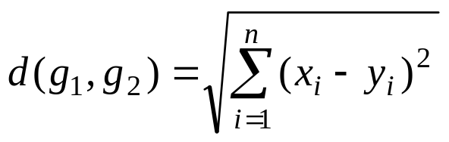
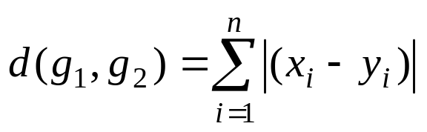
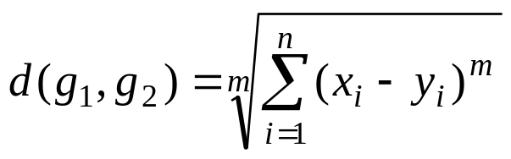
Distance measure
Euclidean distance
Manhattan distance
Minkowski distance

Slide 7
K-means: The Algorithm
Given a set of numeric points in d dimensional space, and integer k
Algorithm generates k (or fewer) clusters as follows:
Assign all points to a cluster at random
Repeat until stable:
Compute centroid for each cluster
Reassign each point to nearest centroid

Slide 8
K-means: Example, k = 3
Step 1: Make random assignments and compute centroids (big dots)
Step 2: Assign points to nearest centroids
Step 3: Re-compute centroids (in this example, solution is now stable)

Slide 9
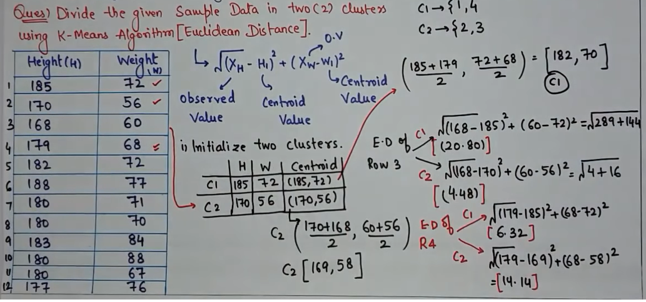
Clustering Using K-Mean (Euclidean Distance)

Slide 10
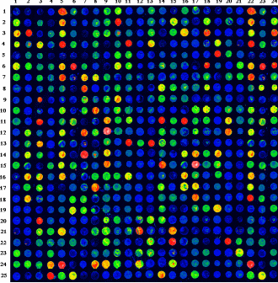
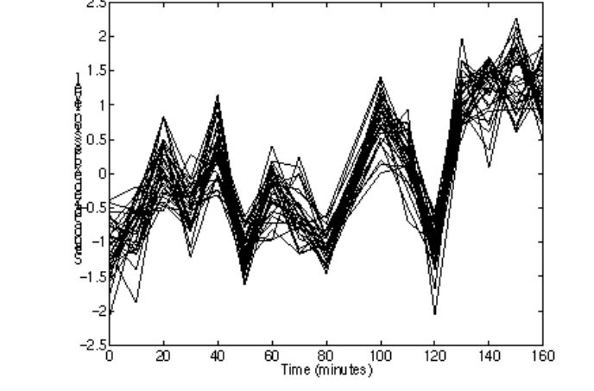
K-means: Sample Application
Gene clustering
  Given a series of microarray experiments measuring the expression of a set of genes at regular time intervals in a common cell line
  Normalization allows comparisons across microarrays.
  Produce clusters of genes which vary in similar ways over time
  Hypothesis: genes which vary in the same way may be co-regulated and/or participate in the same pathway
Sample Array. Rows are genes and columns are time points.
A cluster of co-regulated genes.

Slide 11
K-means: Weaknesses
Must choose parameter k in advance or try many values.
Data must be numerical and must be compared via Euclidean distance (there is a variant called the k-medians algorithm to address these concerns)
The algorithm works best on data which contains spherical clusters; clusters with other geometry may not be found.
The algorithm is sensitive to outliers---points which do not belong in any cluster. These can distort the centroid positions and ruin the clustering.

Slide 12
Hierarchical Clustering: The Algorithm
Hierarchical clustering takes as input a set of points
It creates a tree in which the points are leaves and the internal nodes reveal the similarity structure of the points.
  The tree is often called a “dendogram.”
The method is summarized below:
Place all points into their own clusters
While there is more than one cluster, do
Merge the closest pair of clusters
The behavior of the algorithm depends on how “closest pair of clusters” is defined

Slide 13
Hierarchical Clustering: Merging Clusters
Single Link: Distance between two clusters is the distance between the closest points. Also called “neighbor joining.”
Average Link: Distance between clusters is distance between the cluster centroids.
Complete Link: Distance between clusters is distance between farthest pair of points.

Slide 14
Hierarchical Clustering: Example
This example illustrates single-link clustering in Euclidean space on 6 points.
F
E
A
B
C
D
A
B
C
D
E
F

Slide 15
Hierarchical Clustering: Sample Application
Multiple sequence alignment
  Given a set of sequences, produce a global alignment of all sequences against the others
  NP-hard
  One popular heuristic is to use hierarchical clustering
The hierarchical clustering approach
  Each cluster is represented by its consensus sequence
  When clusters are merged, their consensus sequences are aligned via optimal pairwise alignment
  The heuristic uses hierarchical clustering to merge the most similar sequences first, the idea being to minimize potential errors in the alignment.
  A slightly more sophisticated version of this method is implemented by the popular clustalw program

Slide 16
Hierarchical Clustering: Weaknesses
The most commonly used type, single-link clustering, is particularly greedy.
  If two points from disjoint clusters happen to be near each other, the distinction between the clusters will be lost.
  On the other hand, average- and complete-link clustering methods are biased towards spherical clusters in the same way as k-means
Does not really produce clusters; the user must decide where to split the tree into groups.
  Some automated tools exist for this
As with k-means, sensitive to noise and outliers

Slide 17
Challenges in Clustering
Similarity Calculation
  Results of algorithms depend entirely on similarity used
  Clustering systems provide little guidance on how to pick similarity
  Computing similarity of mixed-type data is hard
  Similarity is very dependent on data representation. Should one
    Normalize?
    Represent one’s data numerically, categorically, etc.?
    Cluster on only a subset of the data?
    The computer should do more to help the user figure this out!
Parameter selection
  Current algorithms require too many arbitrary, user-specified parameters

Slide 18
Conclusion
Clustering is a useful way of exploring data, but is still very ad hoc
Good results are often dependent on choosing the right data representation and similarity metric
  Data: categorical, numerical, boolean
  Similarity: distance, correlation, etc.
Many different choices of algorithms, each with different strengths and weaknesses
  k-means, hierarchical, graph partitioning, etc.

